Slide 1
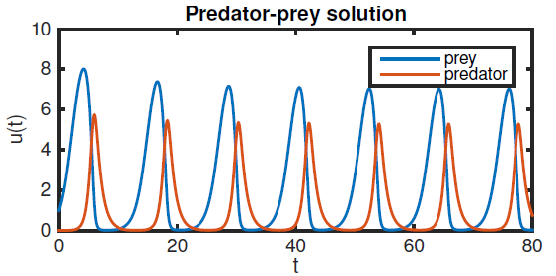
Chapter 6 Initial value problem (IVPs)

Slide 2
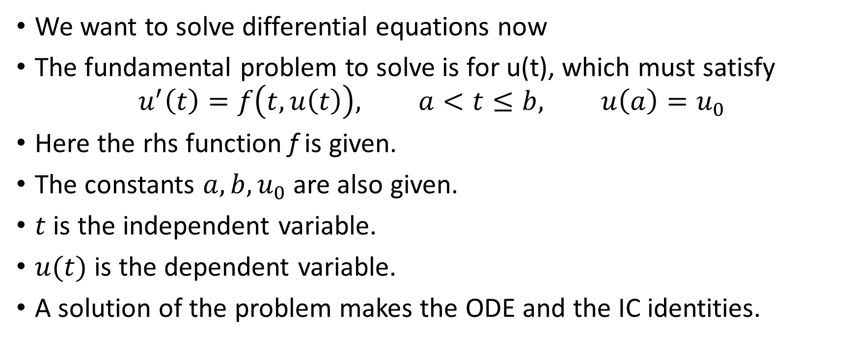
Initial value prolbems, or IVPs
We want to solve differential equations now
The fundamental problem to solve is for u(t), which must satisfy
$$u^{′}\left(t\right)=f\left(t,u\left(t\right)\right), a<t≤b, u\left(a\right)=u_{0}$$
Here the rhs function f is given.
The constants $a, b, u_{0}$are also given.
$t$ is the independent variable.
$u(t)$ is the dependent variable.
A solution of the problem makes the ODE and the IC identities.

Slide 3
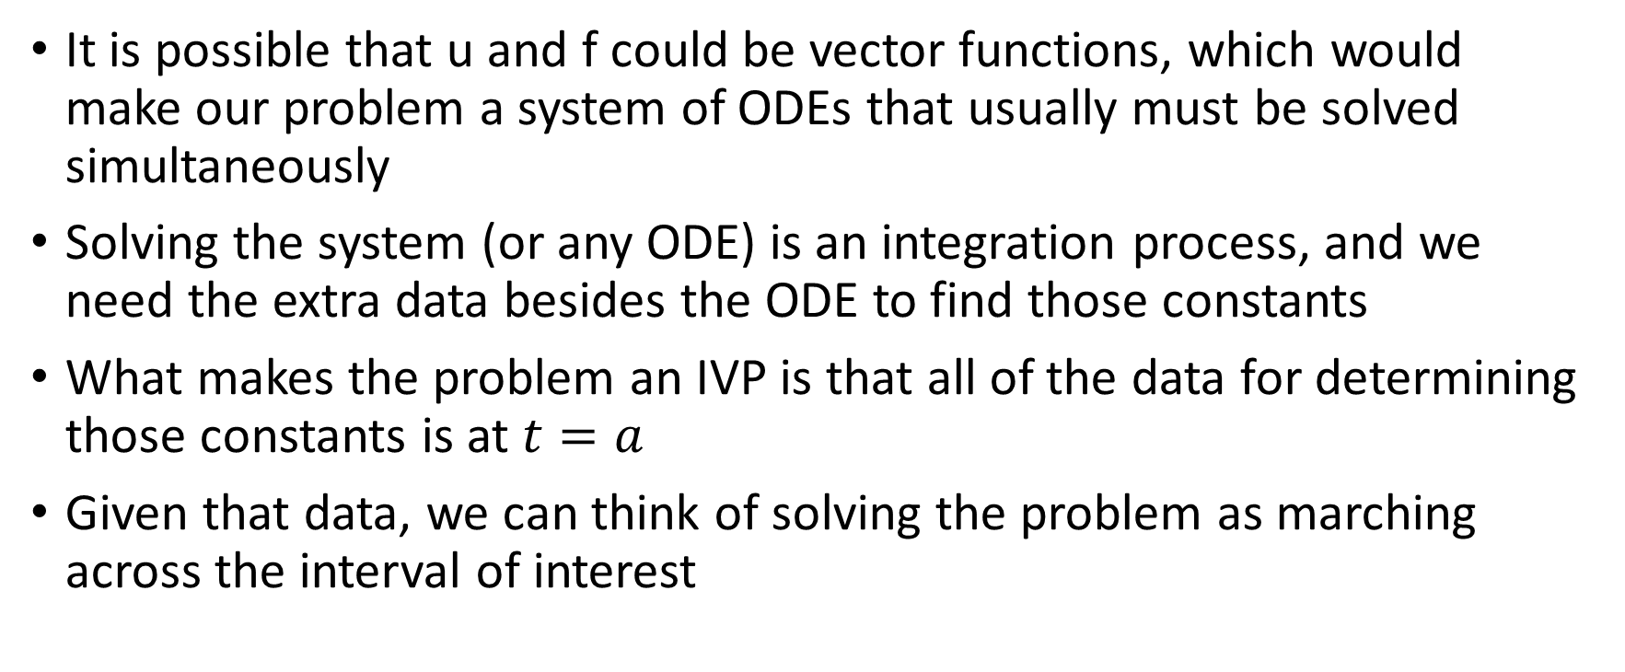
IVPs
It is possible that u and f could be vector functions, which would make our problem a system of ODEs that usually must be solved simultaneously
Solving the system (or any ODE) is an integration process, and we need the extra data besides the ODE to find those constants
What makes the problem an IVP is that all of the data for determining those constants is at $t=a$
Given that data, we can think of solving the problem as marching across the interval of interest

Slide 4
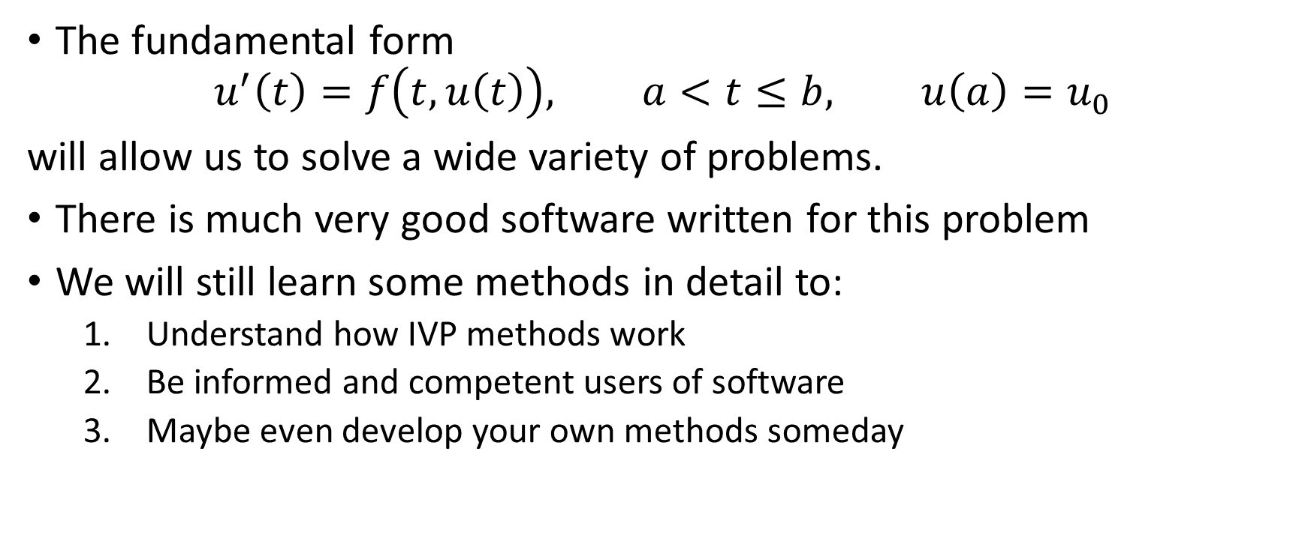
Initial value problems, or IVPs
The fundamental form
$$u^{′}\left(t\right)=f\left(t,u\left(t\right)\right), a<t≤b, u\left(a\right)=u_{0}$$
will allow us to solve a wide variety of problems.
There is much very good software written for this problem
We will still learn some methods in detail to:
Understand how IVP methods work
Be informed and competent users of software
Maybe even develop your own methods someday

Slide 5
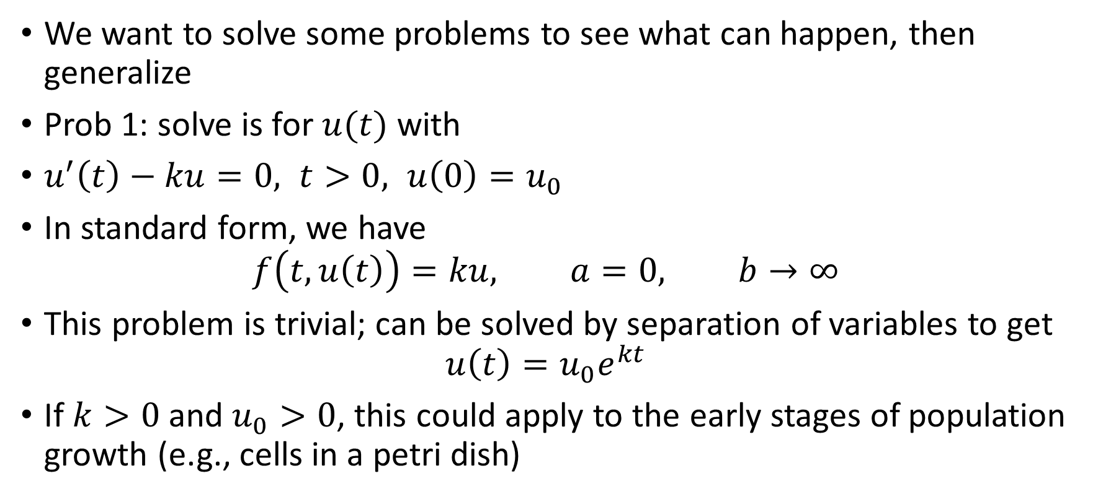
Example IVPs
We want to solve some problems to see what can happen, then generalize
Prob 1: solve is for $u(t)$ with
$u^{′}\left(t\right)−ku=0, t>0, u\left(0\right)=u_{0}$
In standard form, we have
$$f\left(t,u\left(t\right)\right)=ku, a=0, b→∞$$
This problem is trivial; can be solved by separation of variables to get
$$u\left(t\right)=u_{0}e^{kt}$$
If $k>0$ and $u_{0}>0$, this could apply to the early stages of population growth (e.g., cells in a petri dish)

Slide 6
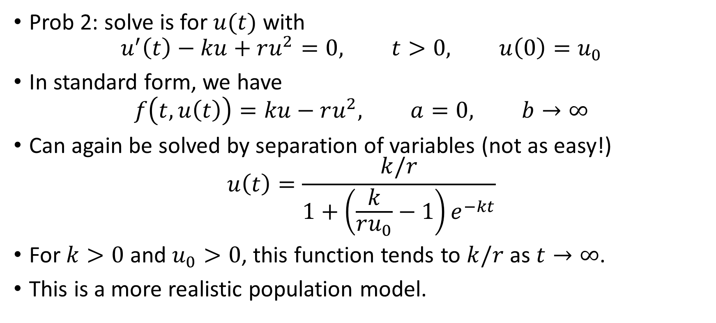
Example IVPs
Prob 2: solve is for $u(t)$ with
$$u^{′}\left(t\right)−ku+ru^{2}=0, t>0, u\left(0\right)=u_{0}$$
In standard form, we have
$$f\left(t,u\left(t\right)\right)=ku−ru^{2}, a=0, b→∞$$
Can again be solved by separation of variables (not as easy!)
$$u\left(t\right)=\frac{k/r}{1+\left(\frac{k}{ru_{0}}−1\right)e^{−kt}}$$
For $k>0$ and $u_{0}>0$, this function tends to $k/r$ as $t→∞$.
This is a more realistic population model.

Slide 7
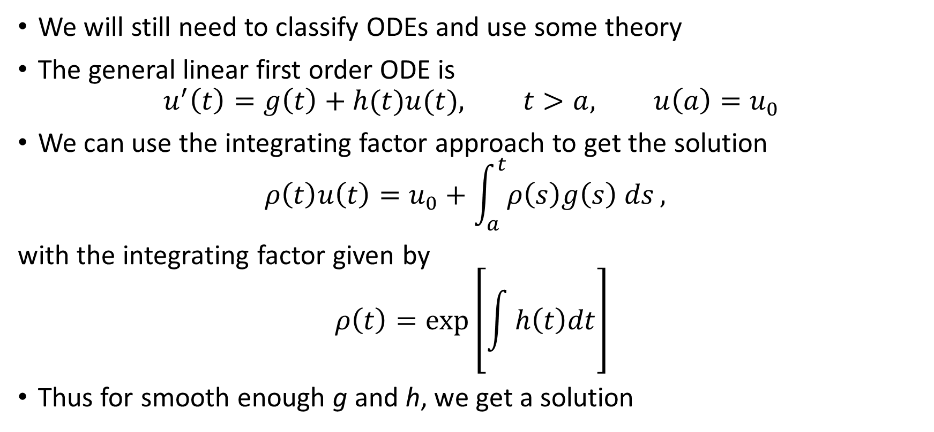
Some IVP theory
We will still need to classify ODEs and use some theory
The general linear first order ODE is
$$u^{′}\left(t\right)=g\left(t\right)+h(t)u(t), t>a, u\left(a\right)=u_{0}$$
We can use the integrating factor approach to get the solution
$$ρ\left(t\right)u\left(t\right)=u_{0}+\int_{a}^{t}{ρ\left(s\right)g\left(s\right) ds},$$
with the integrating factor given by
$$ρ\left(t\right)=\exp\left[\int{h\left(t\right)dt}\right]$$
Thus for smooth enough g and h, we get a solution

Slide 8
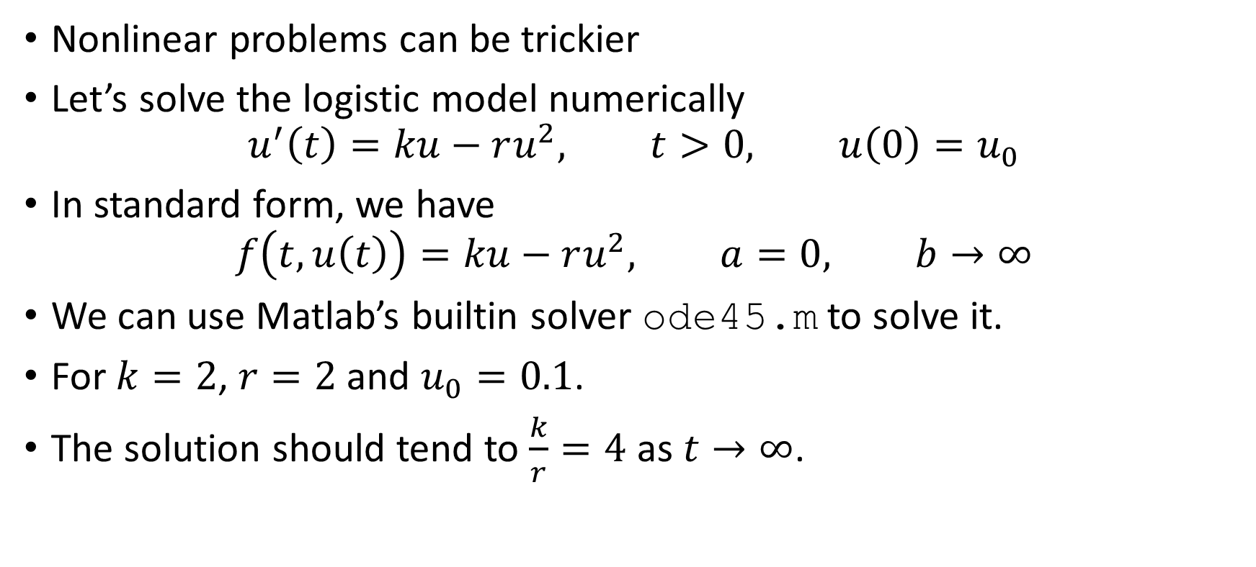
IVPs
Nonlinear problems can be trickier
Let’s solve the logistic model numerically
$$u^{′}\left(t\right)=ku−ru^{2}, t>0, u\left(0\right)=u_{0}$$
In standard form, we have
$$f\left(t,u\left(t\right)\right)=ku−ru^{2}, a=0, b→∞$$
We can use Matlab’s builtin solver ode45.m to solve it.
For $k=2$, $r=2$ and $u_{0}=0.1$.
The solution should tend to $\frac{k}{r}=4$ as $t→∞$.

Slide 9

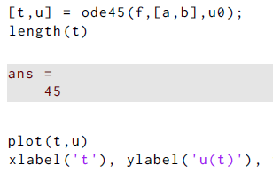
IVPs
Define the functions and constants
Call the solver and plot; 45 time levels were computed

Slide 10
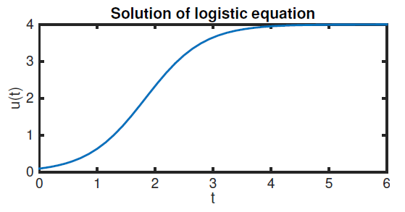
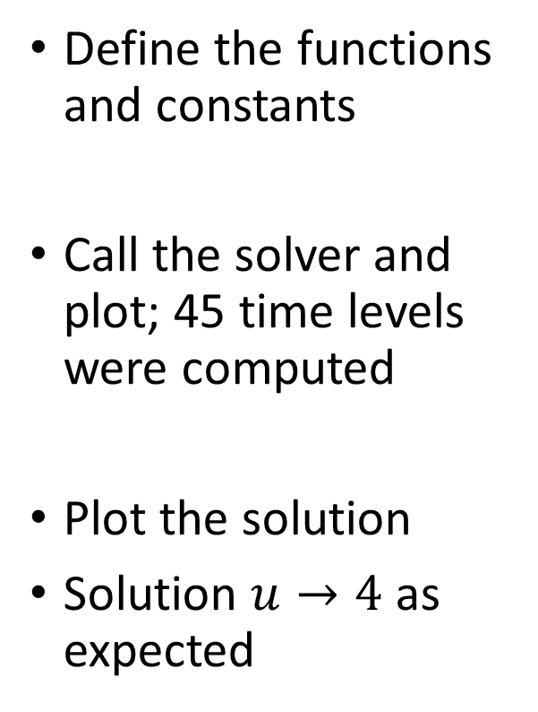
IVPs
Define the functions and constants
Call the solver and plot; 45 time levels were computed
Plot the solution
Solution $u→4$ as expected

Slide 11
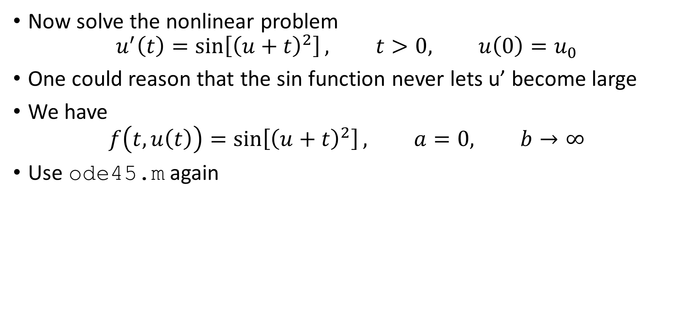
IVPs
Now solve the nonlinear problem
$$u^{′}\left(t\right)=\sin\left[{\left(u+t\right)}^{2}\right], t>0, u\left(0\right)=u_{0}$$
One could reason that the sin function never lets u’ become large
We have
$$f\left(t,u\left(t\right)\right)=\sin\left[{\left(u+t\right)}^{2}\right], a=0, b→∞$$
Use ode45.m again

Slide 12

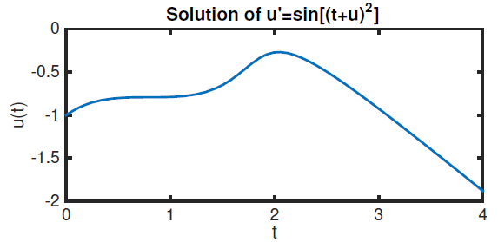
IVPs
Define the functions and constants, call the solver, plot the solution
No worries here

Slide 13
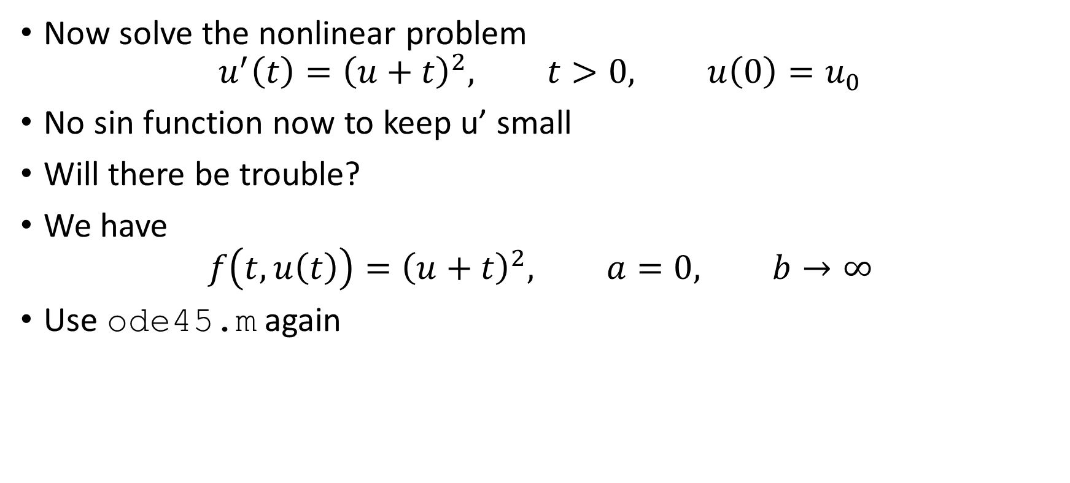
IVPs
Now solve the nonlinear problem
$$u^{′}\left(t\right)={\left(u+t\right)}^{2}, t>0, u\left(0\right)=u_{0}$$
No sin function now to keep u’ small
Will there be trouble?
We have
$$f\left(t,u\left(t\right)\right)={\left(u+t\right)}^{2}, a=0, b→∞$$
Use ode45.m again

Slide 14

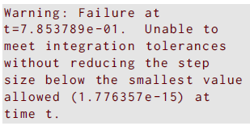
IVPs
Define the functions and constants, call the solver, plot the solution…
No, wait… oops. The solver failed…

Slide 15
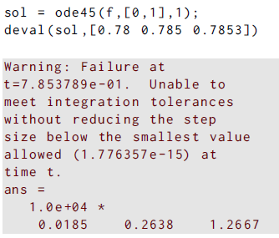
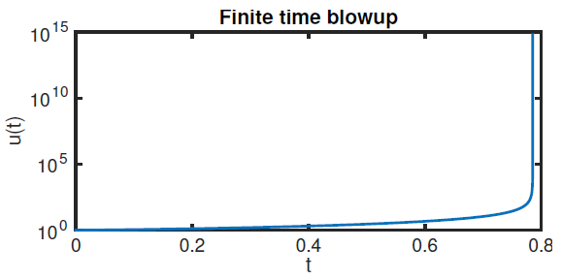
IVPs
Suppose we wanted to look at some values of the solution near blowup
Here’s one way
We try evaluating the stored structure at certain requested points

Slide 16
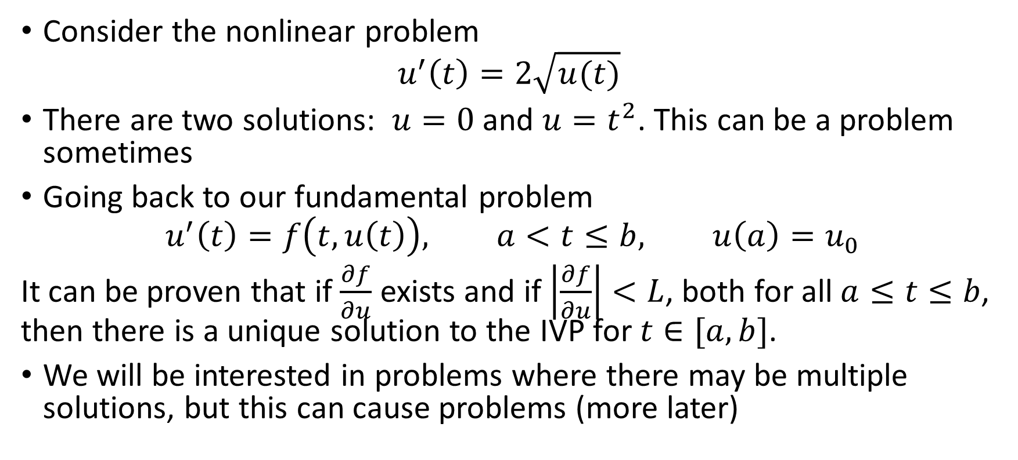
IVPs: some “theoretical” concerns
Consider the nonlinear problem
$$u^{′}\left(t\right)=2\sqrt{u(t)}$$
There are two solutions: $u=0$ and $u=t^{2}$. This can be a problem sometimes
Going back to our fundamental problem
$$u^{′}\left(t\right)=f\left(t,u\left(t\right)\right), a<t≤b, u\left(a\right)=u_{0}$$
It can be proven that if $\frac{∂f}{∂u}$ exists and if $\left|\frac{∂f}{∂u}\right|<L$, both for all $a≤t≤b$, then there is a unique solution to the IVP for $t∈[a,b]$.
We will be interested in problems where there may be multiple solutions, but this can cause problems (more later)

Slide 17
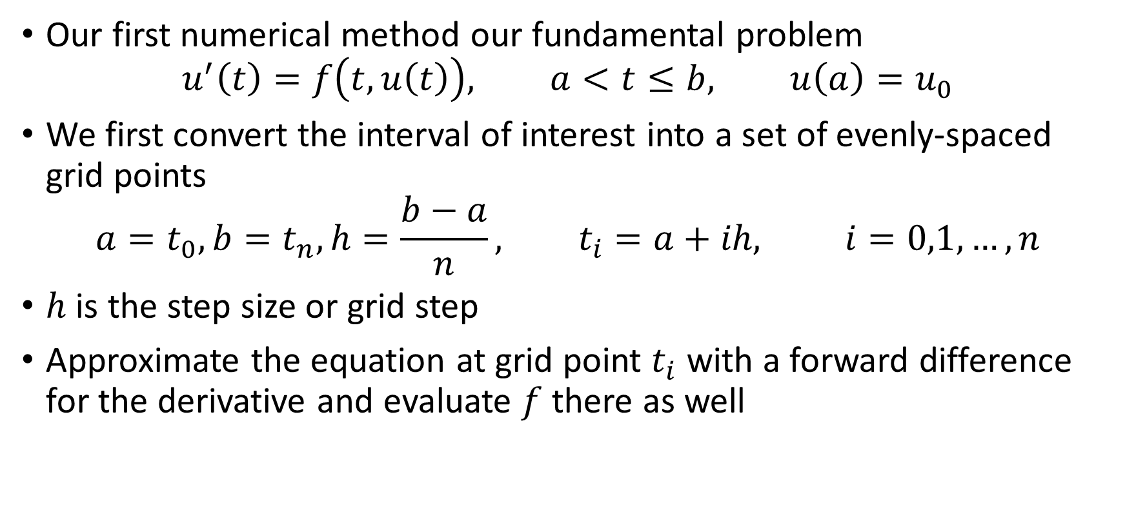
Euler’s method for IVPs
Our first numerical method our fundamental problem
$$u^{′}\left(t\right)=f\left(t,u\left(t\right)\right), a<t≤b, u\left(a\right)=u_{0}$$
We first convert the interval of interest into a set of evenly-spaced grid points
$$a=t_{0}, b=t_{n}, h=\frac{b−a}{n}, t_{i}=a+ih, i=0,1,…,n$$
$h$ is the step size or grid step
Approximate the equation at grid point $t_{i}$ with a forward difference for the derivative and evaluate $f$ there as well

Slide 18
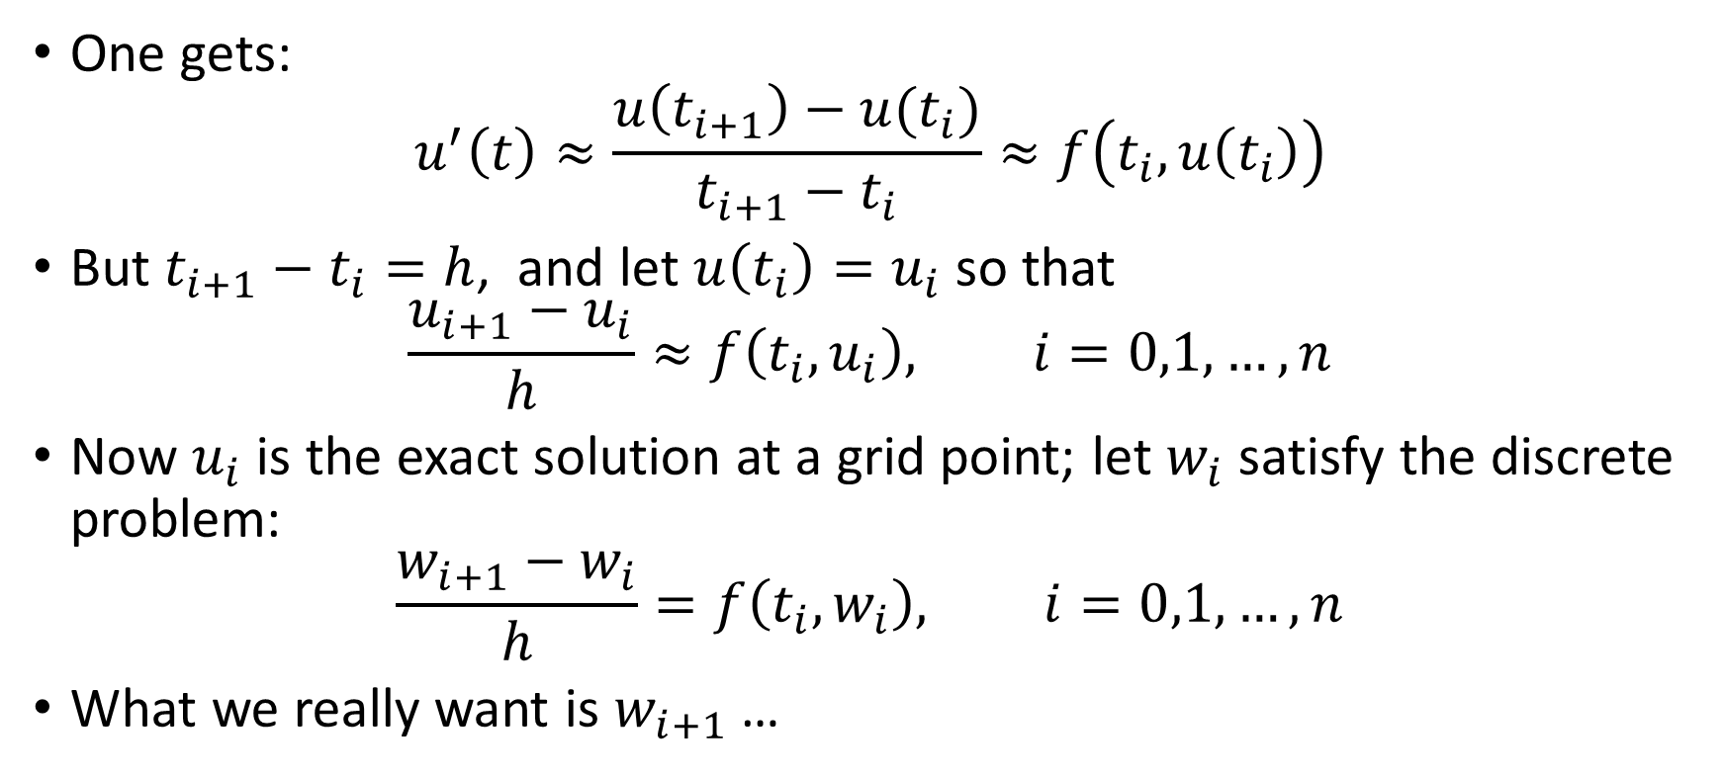
Euler’s method for IVPs
One gets:
$$u^{′}\left(t\right)≈\frac{u\left(t_{i+1}\right)−u(t_{i})}{t_{i+1}−t_{i}}≈f\left(t_{i},u\left(t_{i}\right)\right)$$
But $t_{i+1}−t_{i}=h$, and let $u\left(t_{i}\right)=u_{i}$ so that
$$\frac{u_{i+1}−u_{i}}{h}≈f\left(t_{i},u_{i}\right), i=0,1,…,n$$
Now $u_{i}$ is the exact solution at a grid point; let $w_{i}$ satisfy the discrete problem:
$$\frac{w_{i+1}−w_{i}}{h}=f\left(t_{i},w_{i}\right), i=0,1,…,n$$
What we really want is $w_{i+1}$ …

Slide 19
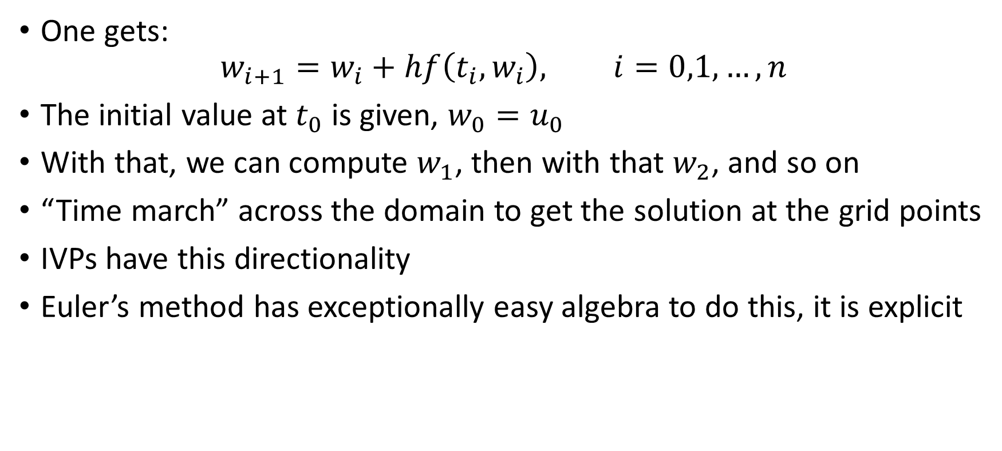
Euler’s method for IVPs
One gets:
$$w_{i+1}=w_{i}+hf\left(t_{i},w_{i}\right), i=0,1,…,n$$
The initial value at $t_{0}$ is given, $w_{0}=u_{0}$
With that, we can compute $w_{1}$, then with that $w_{2}$, and so on
“Time march” across the domain to get the solution at the grid points
IVPs have this directionality
Euler’s method has exceptionally easy algebra to do this, it is explicit

Slide 20
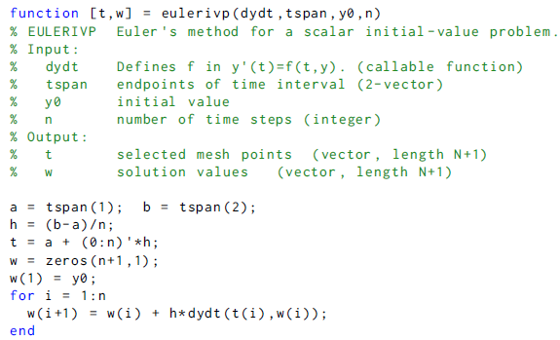
Euler solver function

Slide 21
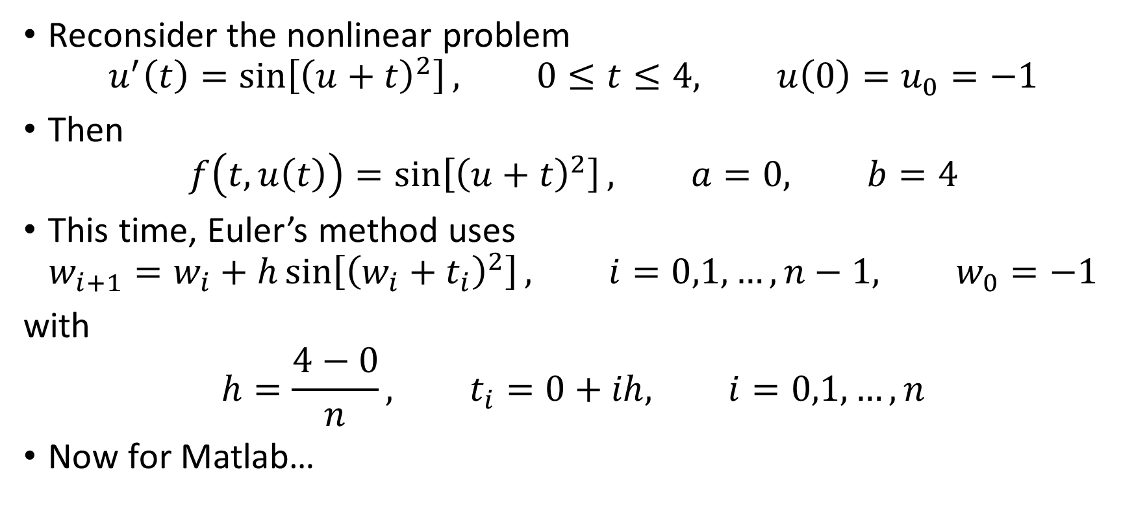
Euler’s method: example
Reconsider the nonlinear problem
$$u^{′}\left(t\right)=\sin\left[{\left(u+t\right)}^{2}\right], 0≤t≤4, u\left(0\right)=u_{0}=−1$$
Then
$$f\left(t,u\left(t\right)\right)=\sin\left[{\left(u+t\right)}^{2}\right], a=0, b=4$$
This time, Euler’s method uses
$$w_{i+1}=w_{i}+h\sin\left[{\left(w_{i}+t_{i}\right)}^{2}\right], i=0,1,…,n−1, w_{0}=−1$$
with
$$h=\frac{4−0}{n}, t_{i}=0+ih, i=0,1,…,n$$
Now for Matlab…

Slide 22
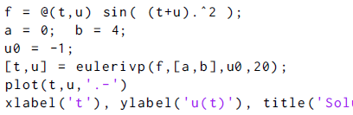
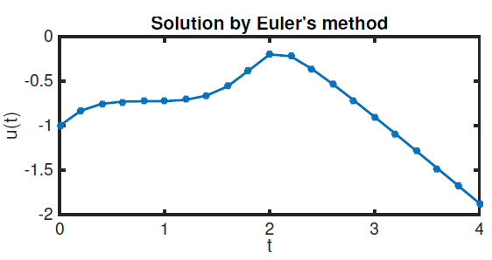
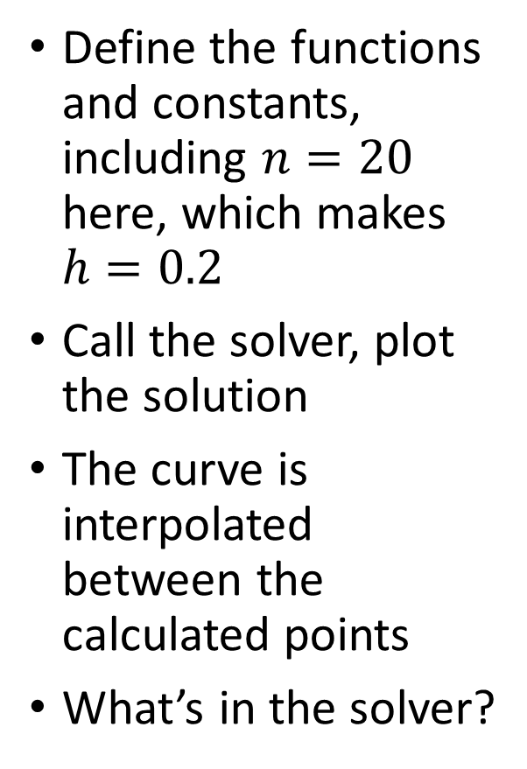
Euler Method ex
Define the functions and constants, including $n=20$ here, which makes $h=0.2$
Call the solver, plot the solution
The curve is interpolated between the calculated points
What’s in the solver?

Slide 23
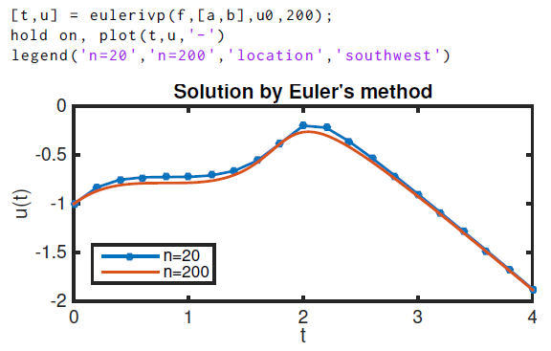

Euler Method ex
Using $n=200$, which makes $h=0.2$ and improves the error

Slide 24
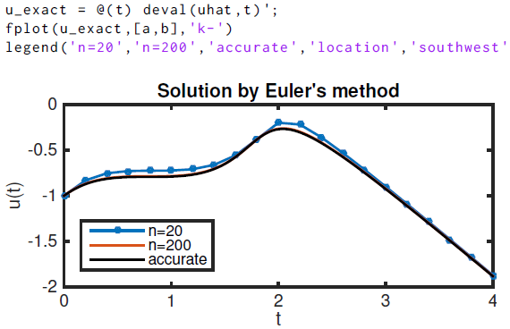
Euler Method ex
Now use a builtin solver ode113 to get a really accuate answer
Compare both Euler results
The n=200 case compares well visually

Slide 25
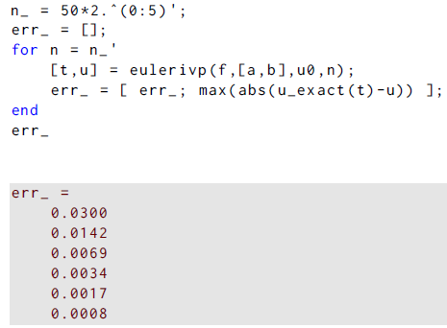
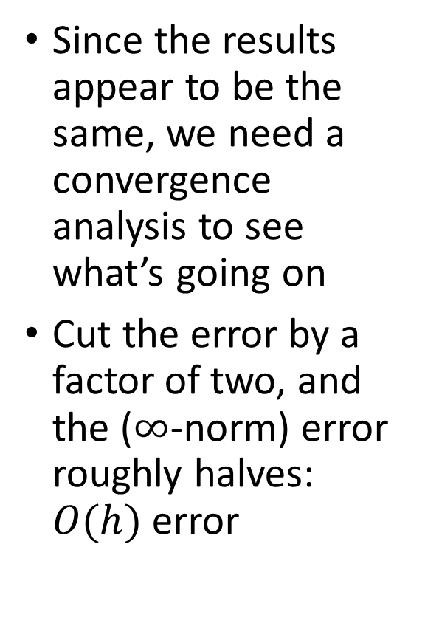
Euler Method ex
Since the results appear to be the same, we need a convergence analysis to see what’s going on
Cut the error by a factor of two, and the ($∞$-norm) error roughly halves: $O(h)$ error

Slide 26

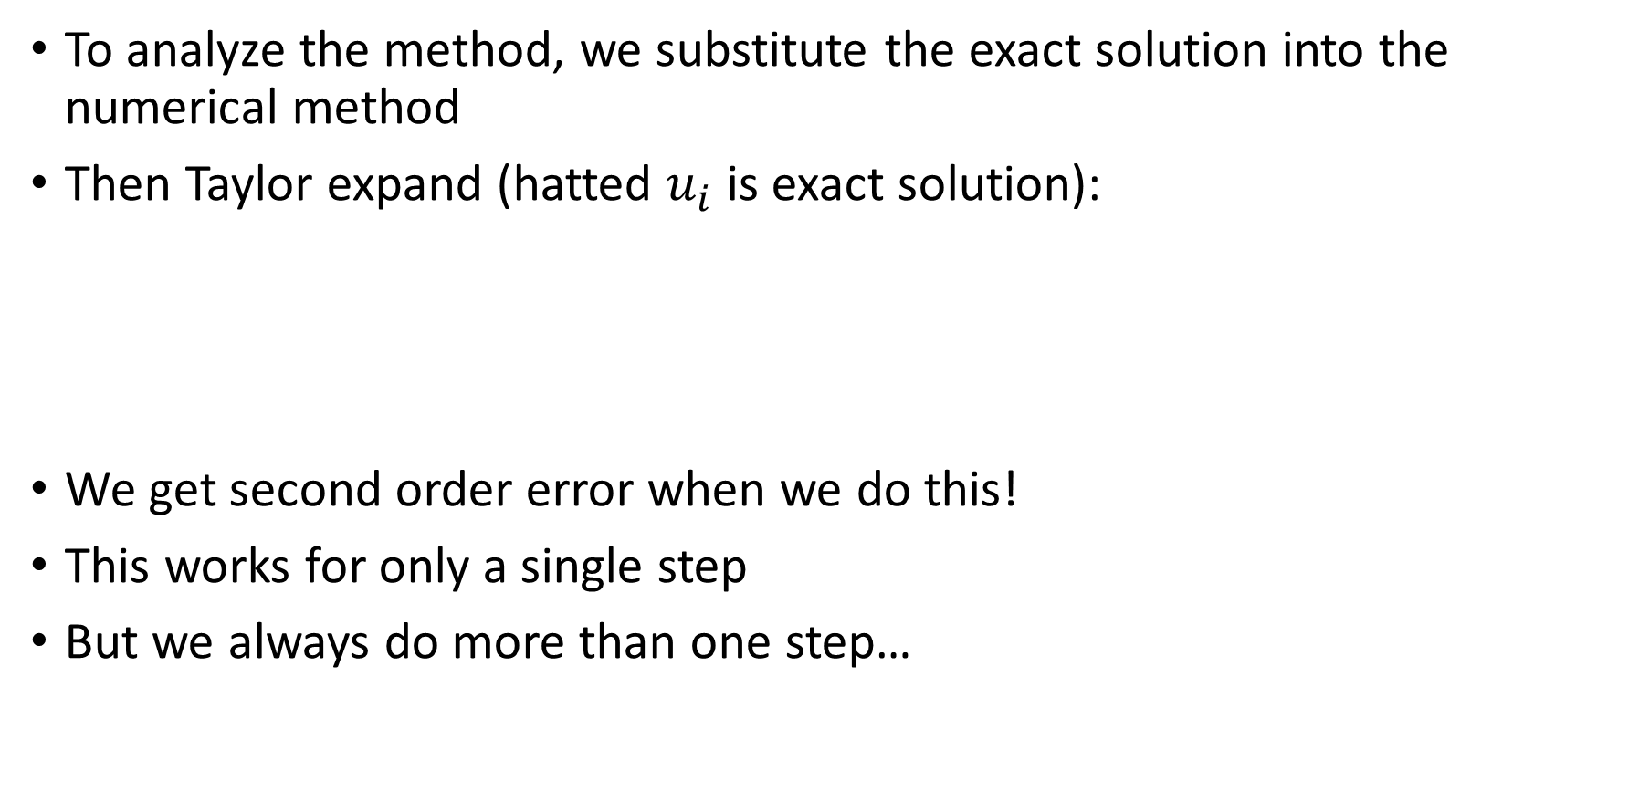
Euler Method analysis
To analyze the method, we substitute the exact solution into the numerical method
Then Taylor expand (hatted $u_{i}$ is exact solution):
We get second order error when we do this!
This works for only a single step
But we always do more than one step…

Slide 27

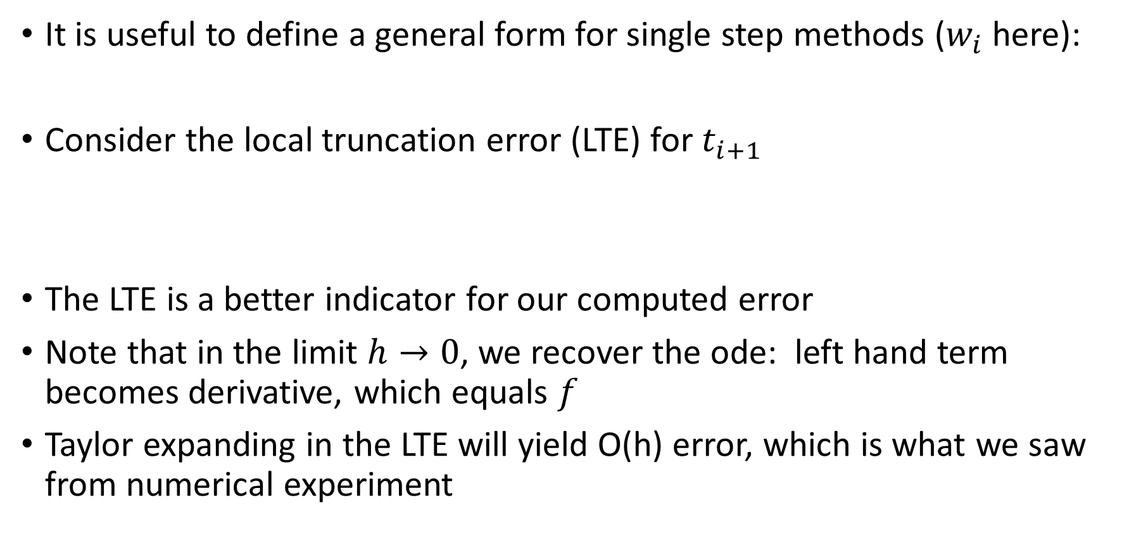
Euler Method analysis
It is useful to define a general form for single step methods ($w_{i}$ here):
Consider the local truncation error (LTE) for $t_{i+1}$
The LTE is a better indicator for our computed error
Note that in the limit $h→0$, we recover the ode: left hand term becomes derivative, which equals $f$
Taylor expanding in the LTE will yield O(h) error, which is what we saw from numerical experiment

Slide 28

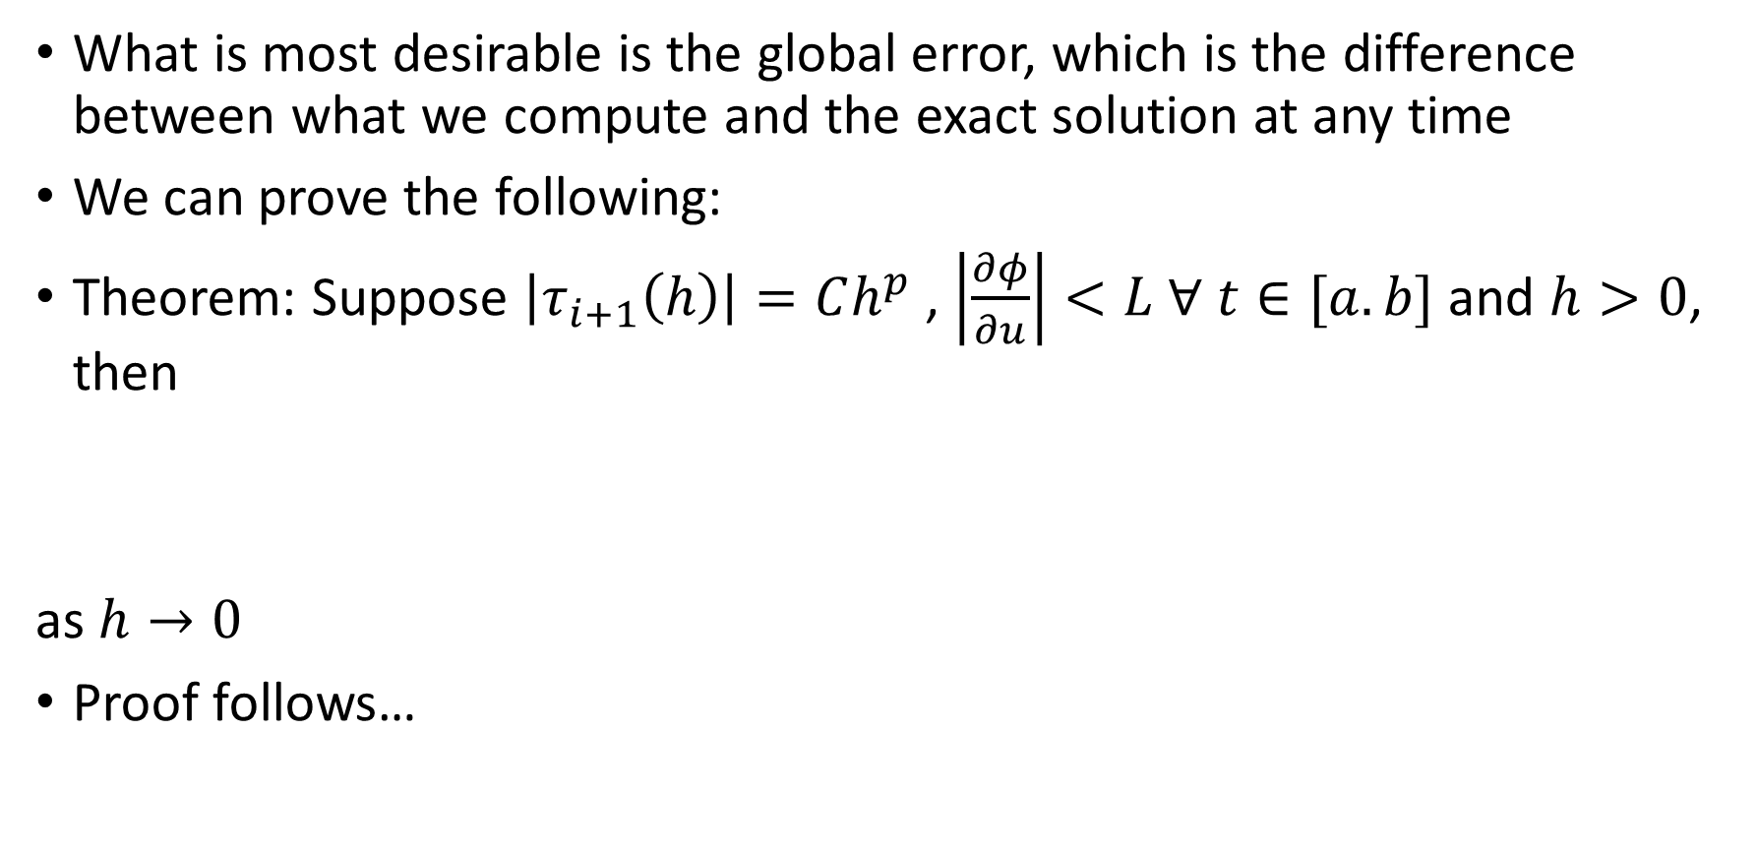
Euler Method analysis
What is most desirable is the global error, which is the difference between what we compute and the exact solution at any time
We can prove the following:
Theorem: Suppose $\left|τ_{i+1}\left(h\right)\right|=Ch^{p}$ , $\left|\frac{∂φ}{∂u}\right|<L ∀ t∈[a.b]$ and $h>0$, then
as $h→0$
Proof follows…

Slide 29


Euler Method analysis
Let the global error at $t_{i}$ be $E_i=u(t_{i})−w_{i}→\hat{u}(t_{i})−u_{i}$
Then

Slide 30

Euler Method analysis
Let the global error at $t_{i}$ be $E_i=u(t_{i})−w_{i}→\hat{u}(t_{i})−u_{i}$
Then
Take absolute, value, use triangle inequality, …

Slide 31
Euler Method analysis
Let the global error at $t_{i}$ be $E_i=u(t_{i})−w_{i}→\hat{u}(t_{i})−u_{i}$
Then
Take absolute, value, use triangle inequality, …

Slide 32

Euler Method analysis
Let the global error at $t_{i}$ be $E_i=u(t_{i})−w_{i}→\hat{u}(t_{i})−u_{i}$
Then
Take absolute, value, use triangle inequality, …
Now use Lipschitz constant L to get rid of $φ$

Slide 33
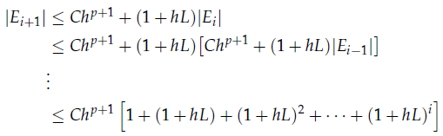

Euler Method analysis
Then
Then replace sum:
Now bound with exponential…

Slide 34
Euler Method analysis
Simplifying the sum gave
Bounding with an exponential gives

Slide 35
Systems of IVPs

Slide 36
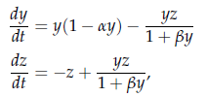
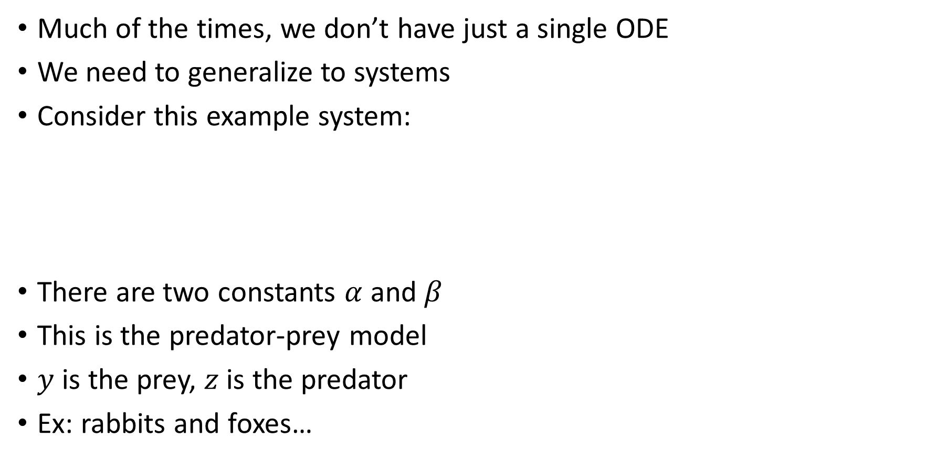
IVP systems
Much of the times, we don’t have just a single ODE
We need to generalize to systems
Consider this example system:
There are two constants $α$ and $β$
This is the predator-prey model
$y$ is the prey, $z$ is the predator
Ex: rabbits and foxes…

Slide 37

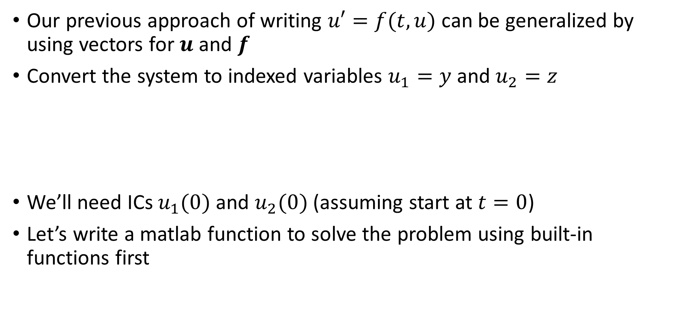
IVP systems: predator-prey model
Our previous approach of writing $u′=f(t,u)$can be generalized by using vectors for $u$ and $f$
Convert the system to indexed variables $u_{1}=y$ and $u_{2}=z$
We’ll need ICs $u_{1}(0)$and $u_{2}(0)$ (assuming start at $t=0$)
Let’s write a matlab function to solve the problem using built-in functions first

Slide 38
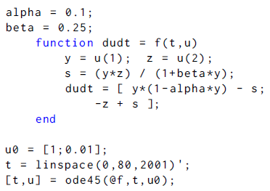
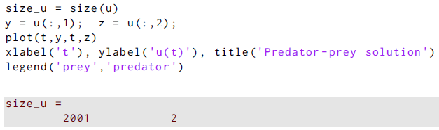
Pred-prey ex
Define the constants
Define the rhs function
Call the solver
Plot the output: one row for each time level
Note the large number of steps

Slide 39
Pred-prey ex
The solutions:
At these parameters, the solutions oscillate
Prey leads the predator
Peaks decline a bit before possibly being periodic
Rabbits in my neighborhood before the foxes; we don’t see too many rabbits any more

Slide 40
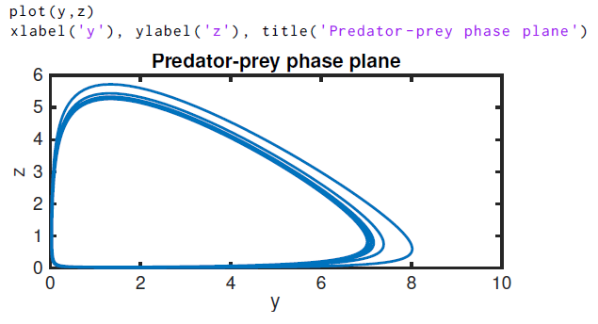
Pred-prey ex
The qualitative nature of the solutions is often revealed by plotting the components against each other: the phase plane
(Most useful for autonomous systems with two or three dependent variables)
Earlier peaks decrease as time goes on
Tending to single
closed curve

Slide 41

IVP systems: higher order problems
Not all problems come as one or more first order ODEs
We can use changes of variable to reduce higher order problems to systems of first order ODEs.
That will allow us to use a our fundamental form to solve even more kinds of problems
Example:
Use the change of variables:
This gives the system:

Slide 42

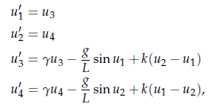
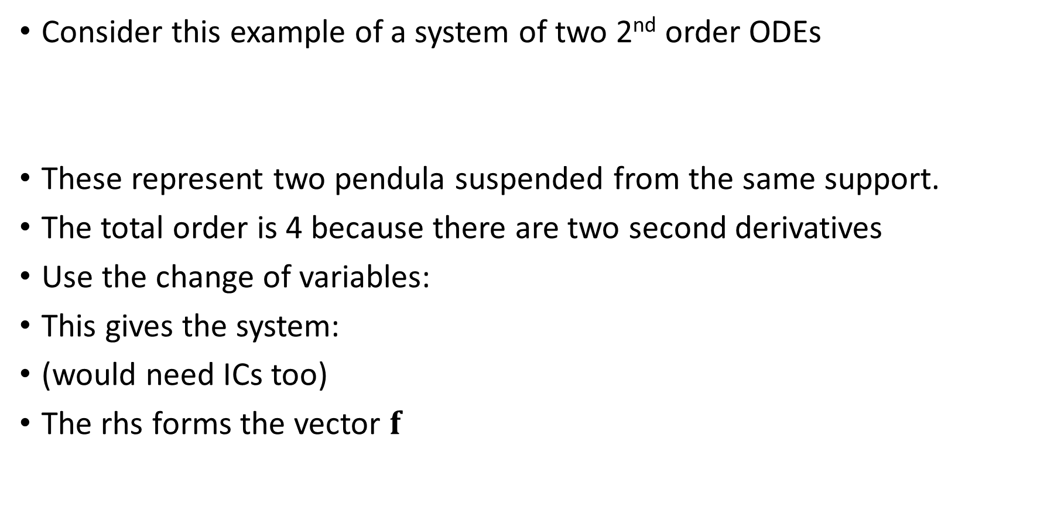
IVP systems: higher order problems
Consider this example of a system of two 2nd order ODEs
These represent two pendula suspended from the same support.
The total order is 4 because there are two second derivatives
Use the change of variables:
This gives the system:
(would need ICs too)
The rhs forms the vector $f$

Slide 43
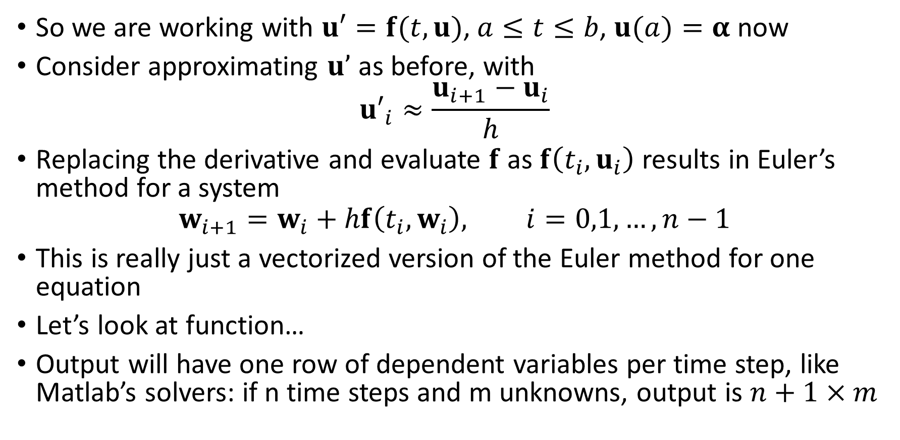
IVP systems: predator-prey model
So we are working with $u′=f(t,u)$, $a≤t≤b$, $u(a)=α$ now
Consider approximating $u’$ as before, with
$${u′}_{i}≈\frac{u_{i+1}−u_{i}}{h}$$
Replacing the derivative and evaluate $f$ as $f\left(t_{i},u_{i}\right)$ results in Euler’s method for a system
$$w_{i+1}=w_{i}+hf\left(t_{i},w_{i}\right), i=0,1,…,n−1$$
This is really just a vectorized version of the Euler method for one equation
Let’s look at function…
Output will have one row of dependent variables per time step, like Matlab’s solvers: if n time steps and m unknowns, output is $n+1×m$

Slide 44
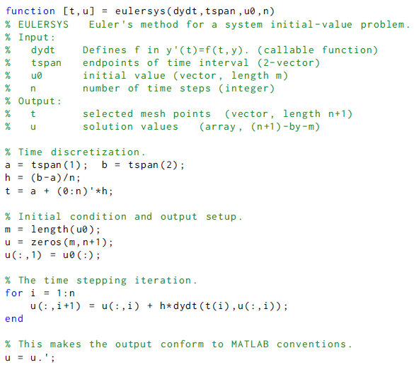
Euler function for systems
We calculate a new column of dependent variables for each time, and transpose at the end to stick with Matlab’s conventions

Slide 45
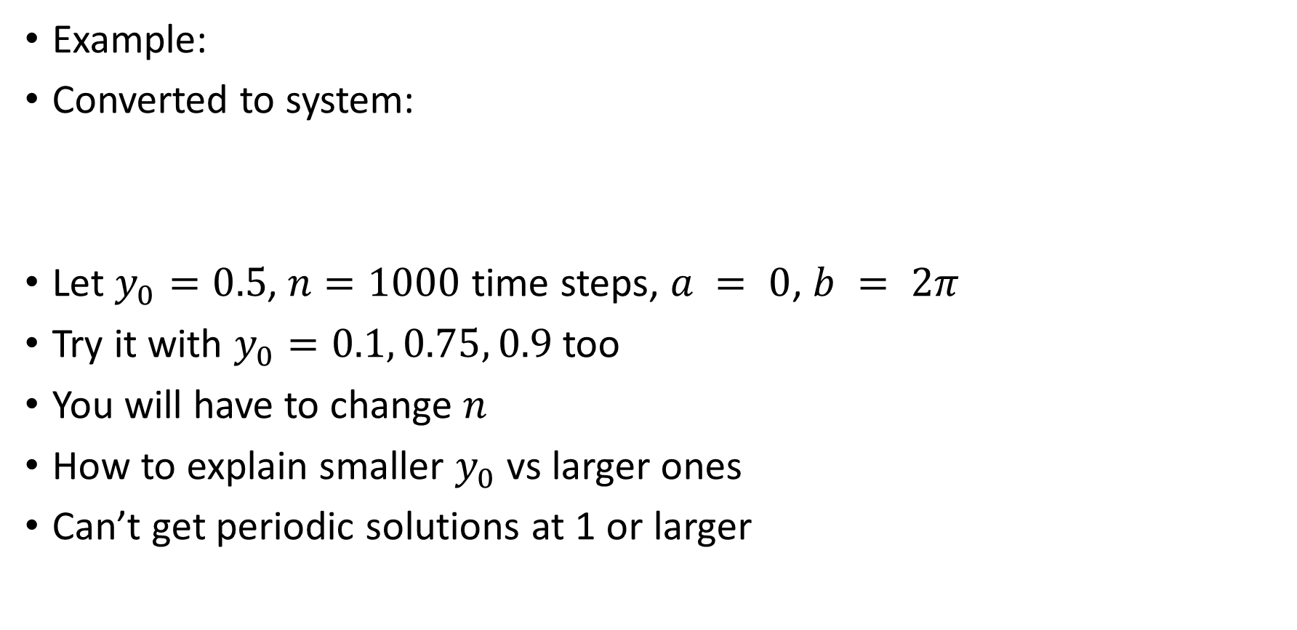
Euler method for systems
Example:
Converted to system:
Let $y_{0}=0.5$, $n=1000$ time steps, $a = 0$, $b = 2π$
Try it with $y_{0}=0.1, 0.75, 0.9$ too
You will have to change $n$
How to explain smaller $y_{0}$ vs larger ones
Can’t get periodic solutions at 1 or larger

Slide 46
Runge-Kutta methods

